Slide 1
Team Signal Your Sign Language Interpreter
Members: Andric Ang
Wong Zhao Wu

Slide 2

Landing Page
This is the page that users see when they are not logged into an account.
Existing Users are able to access the login page from here by clicking the login button

Slide 3
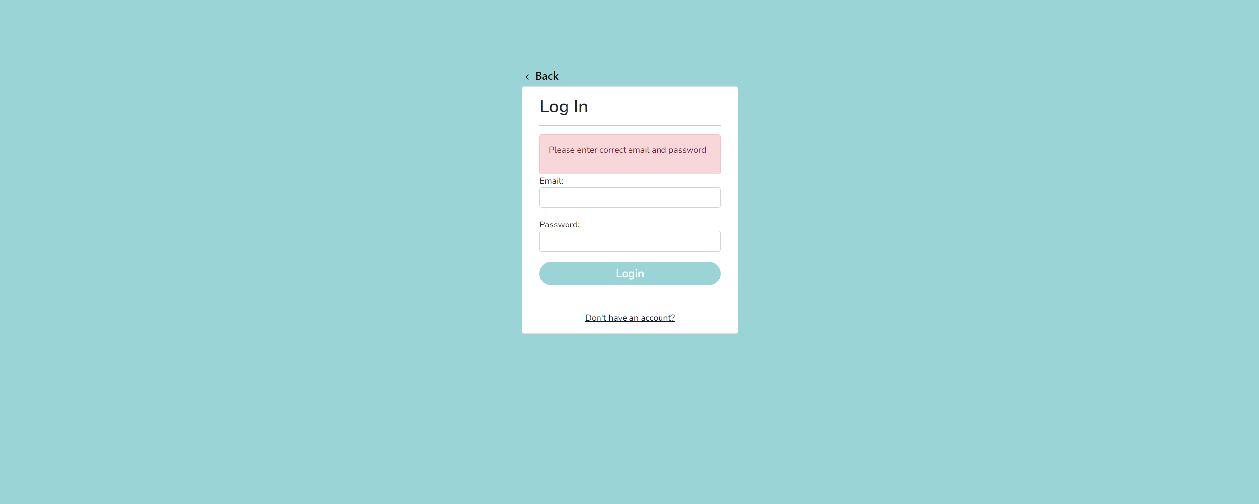
Login Page
This is the page users visit to login to their accounts.
As you can see here, there is an alert that will appear when there are invalid credentials inputted into the fields

Slide 4
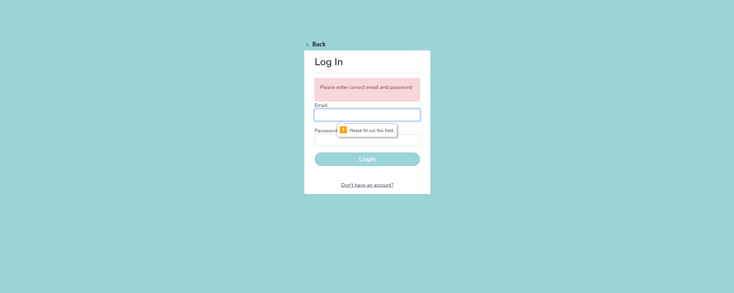
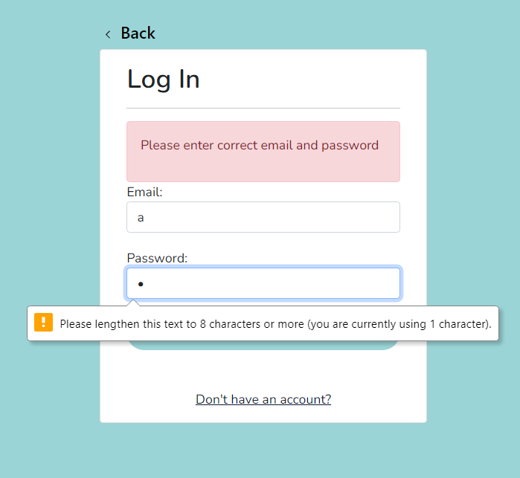
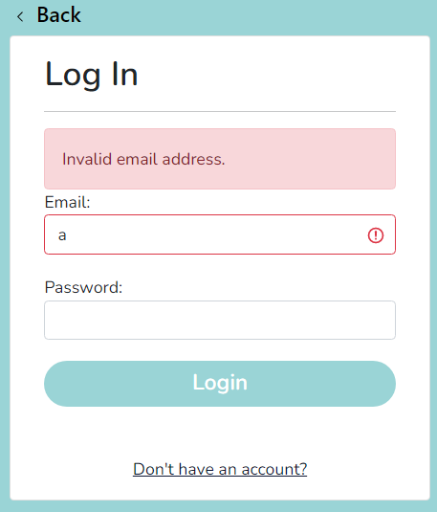
Login Page Validations
This shows the empty field validation, insufficient length validation and also invalid field validation

Slide 5
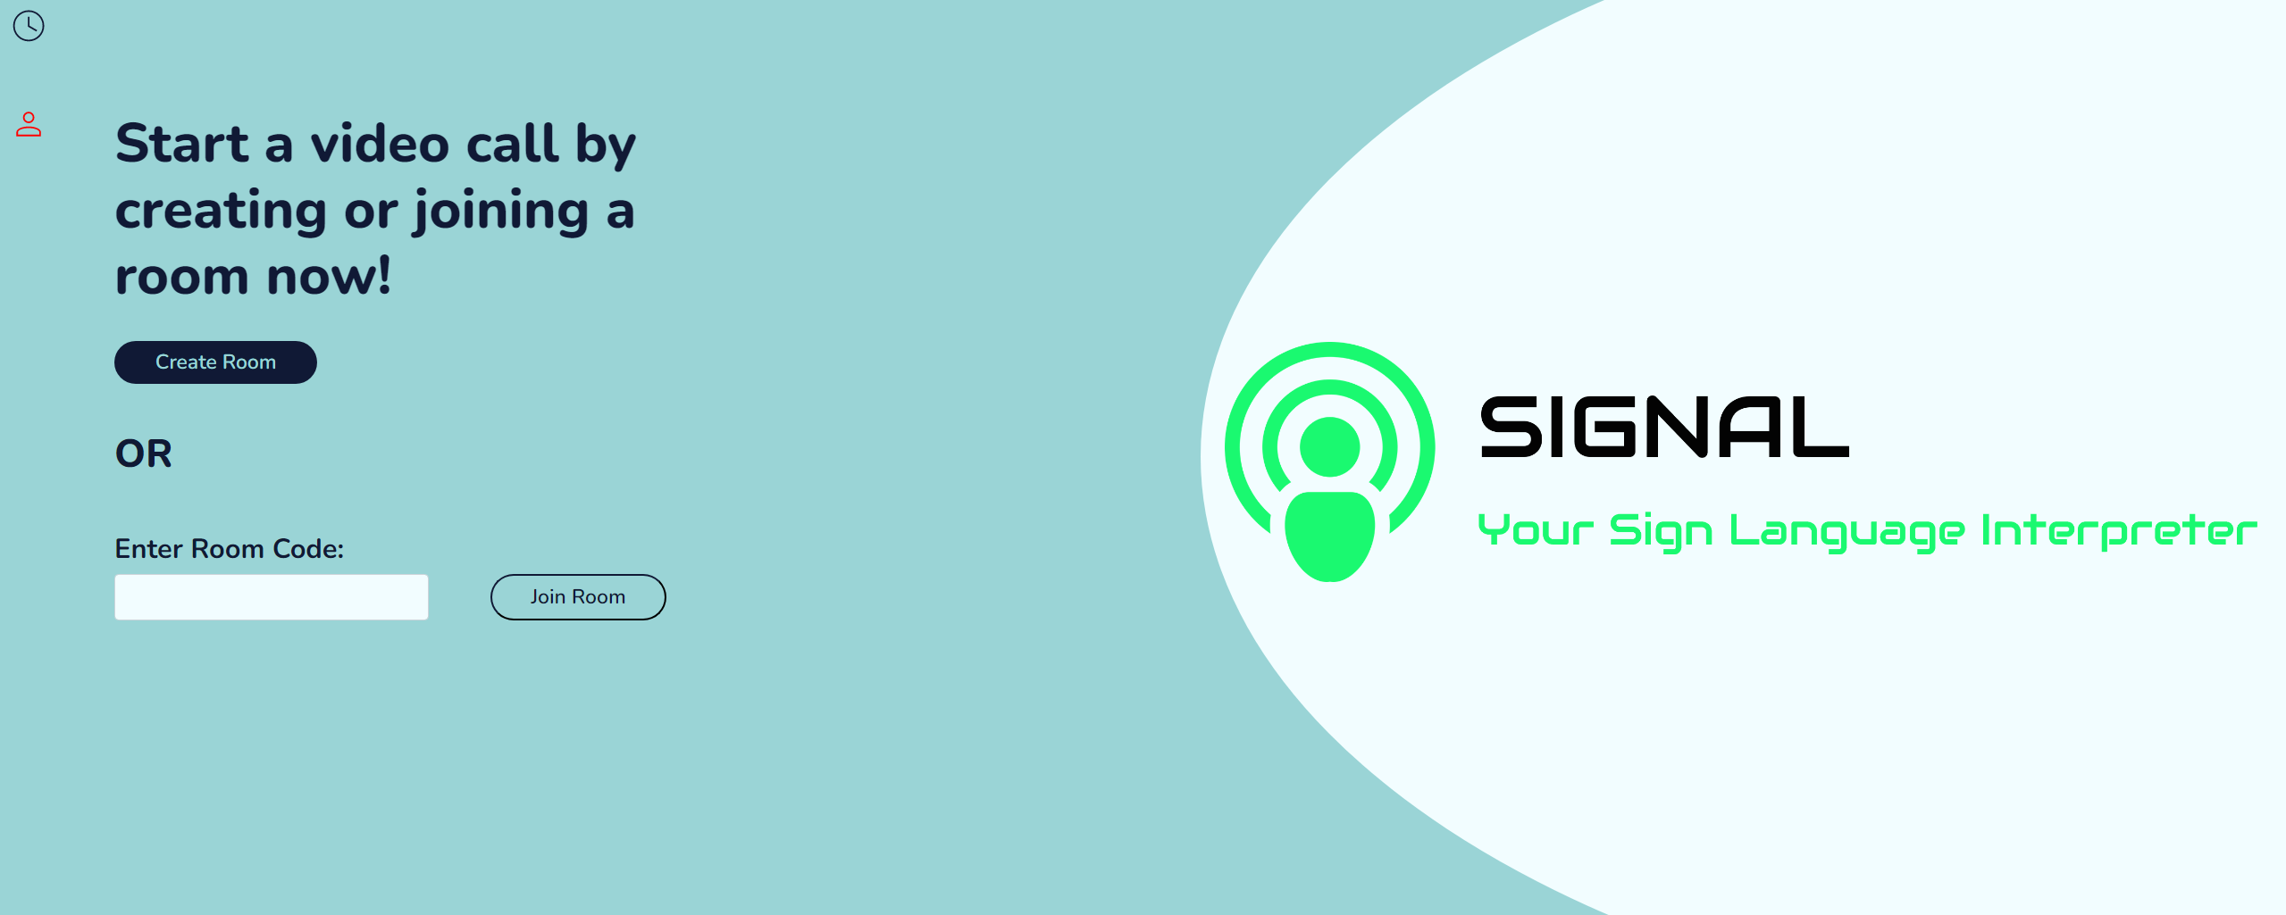
Home Page
This is the page users see when they are logged into their accounts.
From this page, they can create a room and also join rooms.

Slide 6
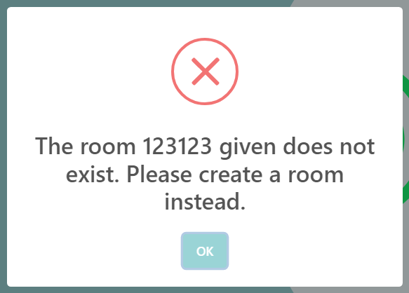
Validation for Home Page

Slide 7
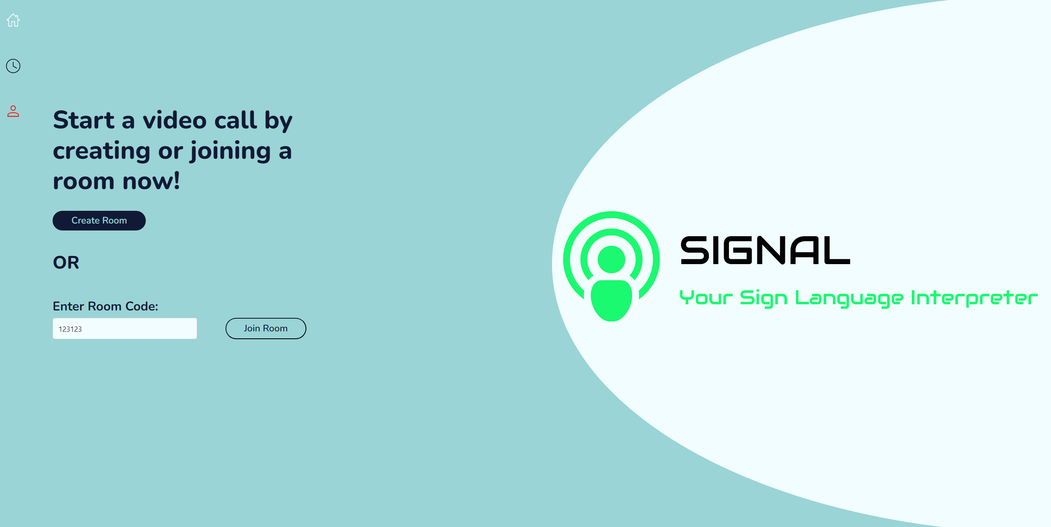
Logging Out

Slide 8
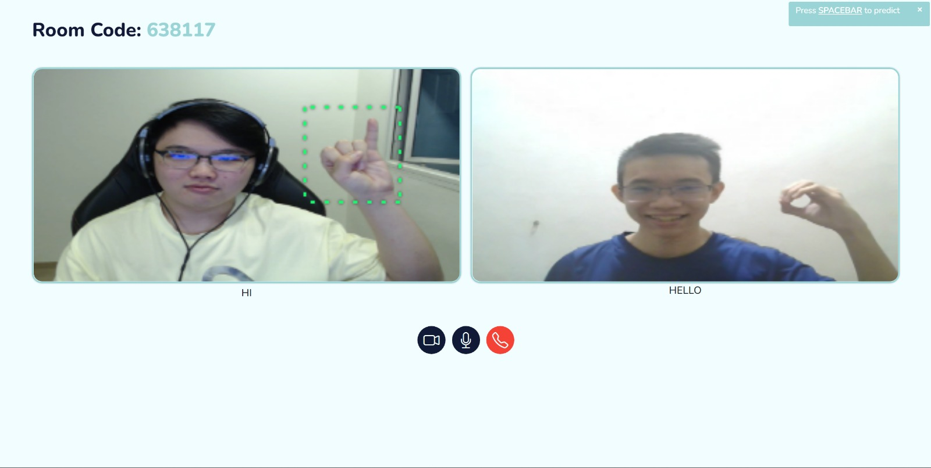
Creating New Room
After creating clicking the create room button, users are taken to this page. Where they can give whoever they want to video call the room code that can be found on the top left of the screen.
They can also disable their webcams, mute their microphones and also disconnect from the call using the buttons at the bottom of the screen.

Slide 9
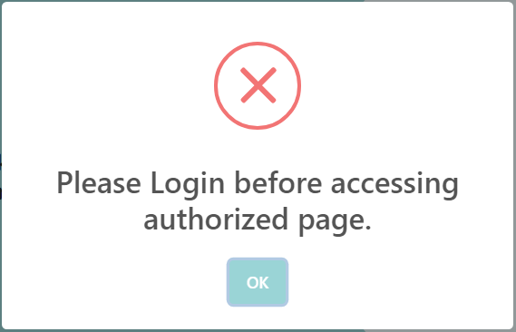
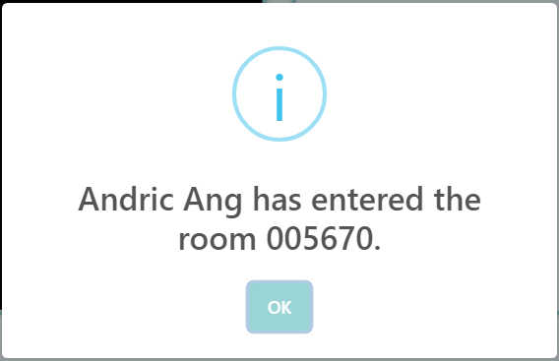
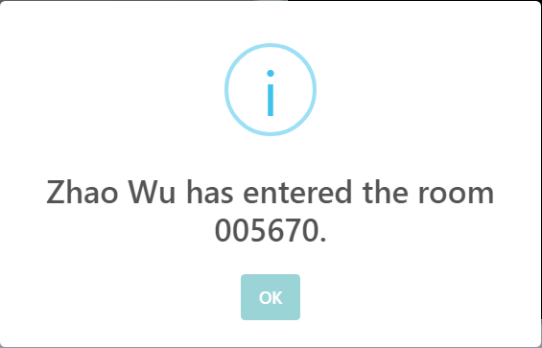
Validation and Information Alerts for Room Page

Slide 10
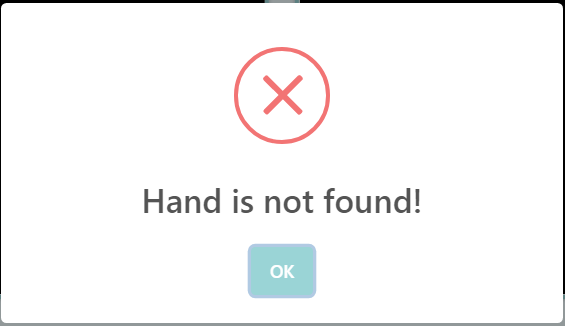
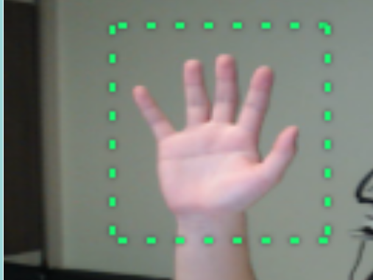
Predicting Handsigns
During the video call, our AI will be automatically tracking where your hands are as long as its within frame of the camera
When our AI detects your hand, it will show a green bounding box that is surrounding your hand and will track where you move it
If you press space to predict and our AI is unable to detect your hand, it will show the alert “Hand is not found!”

Slide 11

After predicting a Handsign The prediction for that handsign will be shown as a caption underneath the camera frame. The captions can be seen by both users in the call and the captions will be underneath the video of the person who predicted it
Live Prediction Captions

Slide 12
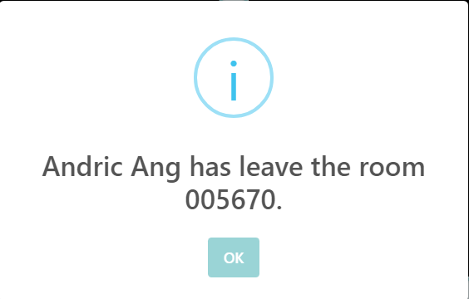
Information Alerts for Leaving Room Page

Slide 13
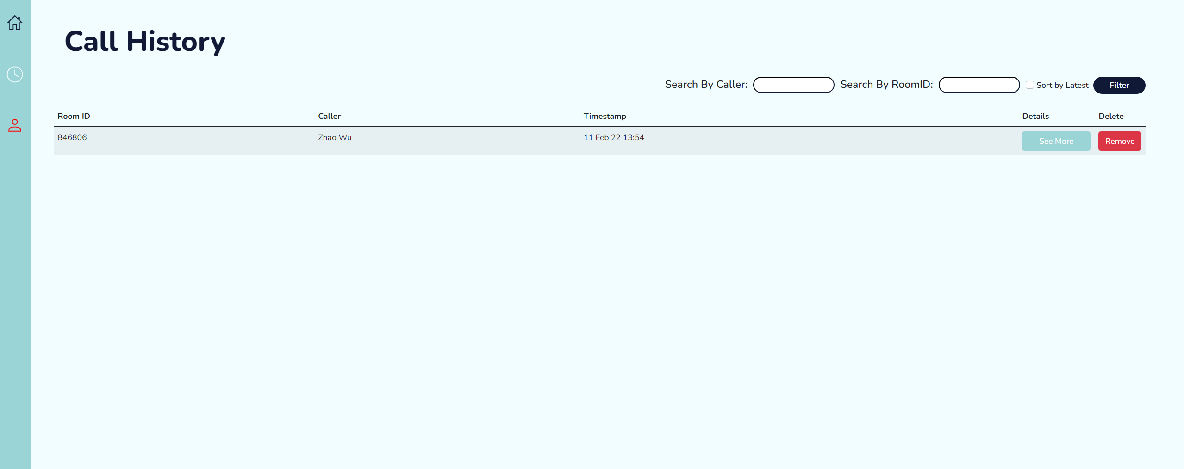
Call History Page
From this page users can view their call history. They can see the Room ID they had their call in and who they were calling. And also the Timestamp.
Users can click on the See More buttons to view the details of the call
Users can also click on the Remove button to remove that call from their history
At the top of the page you can see that users are able to search by Caller and Room ID and also sort by latest

Slide 14
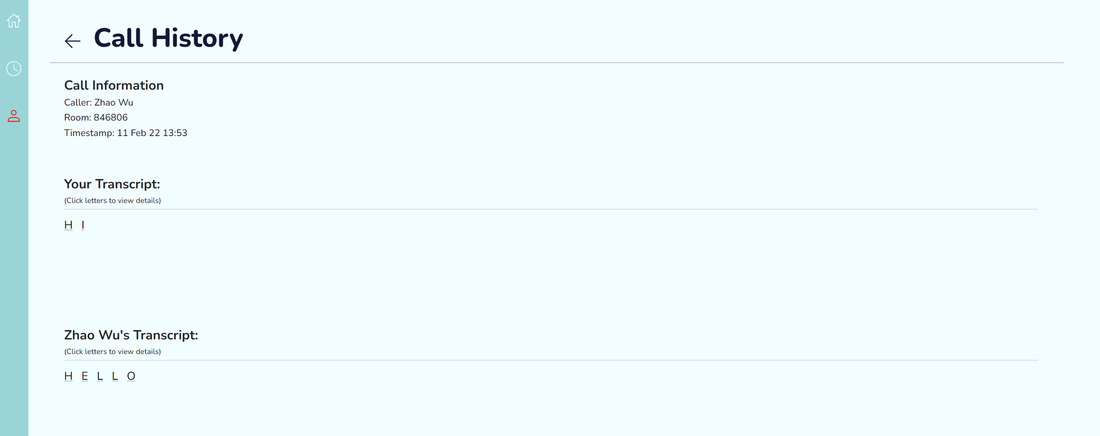
See More Details Page
After clicking See More on the previous page, it would bring you to this page, where you can see the transcript of predictions from both users. You can see that the transcript saves what we predicted just now in the call.

Slide 15
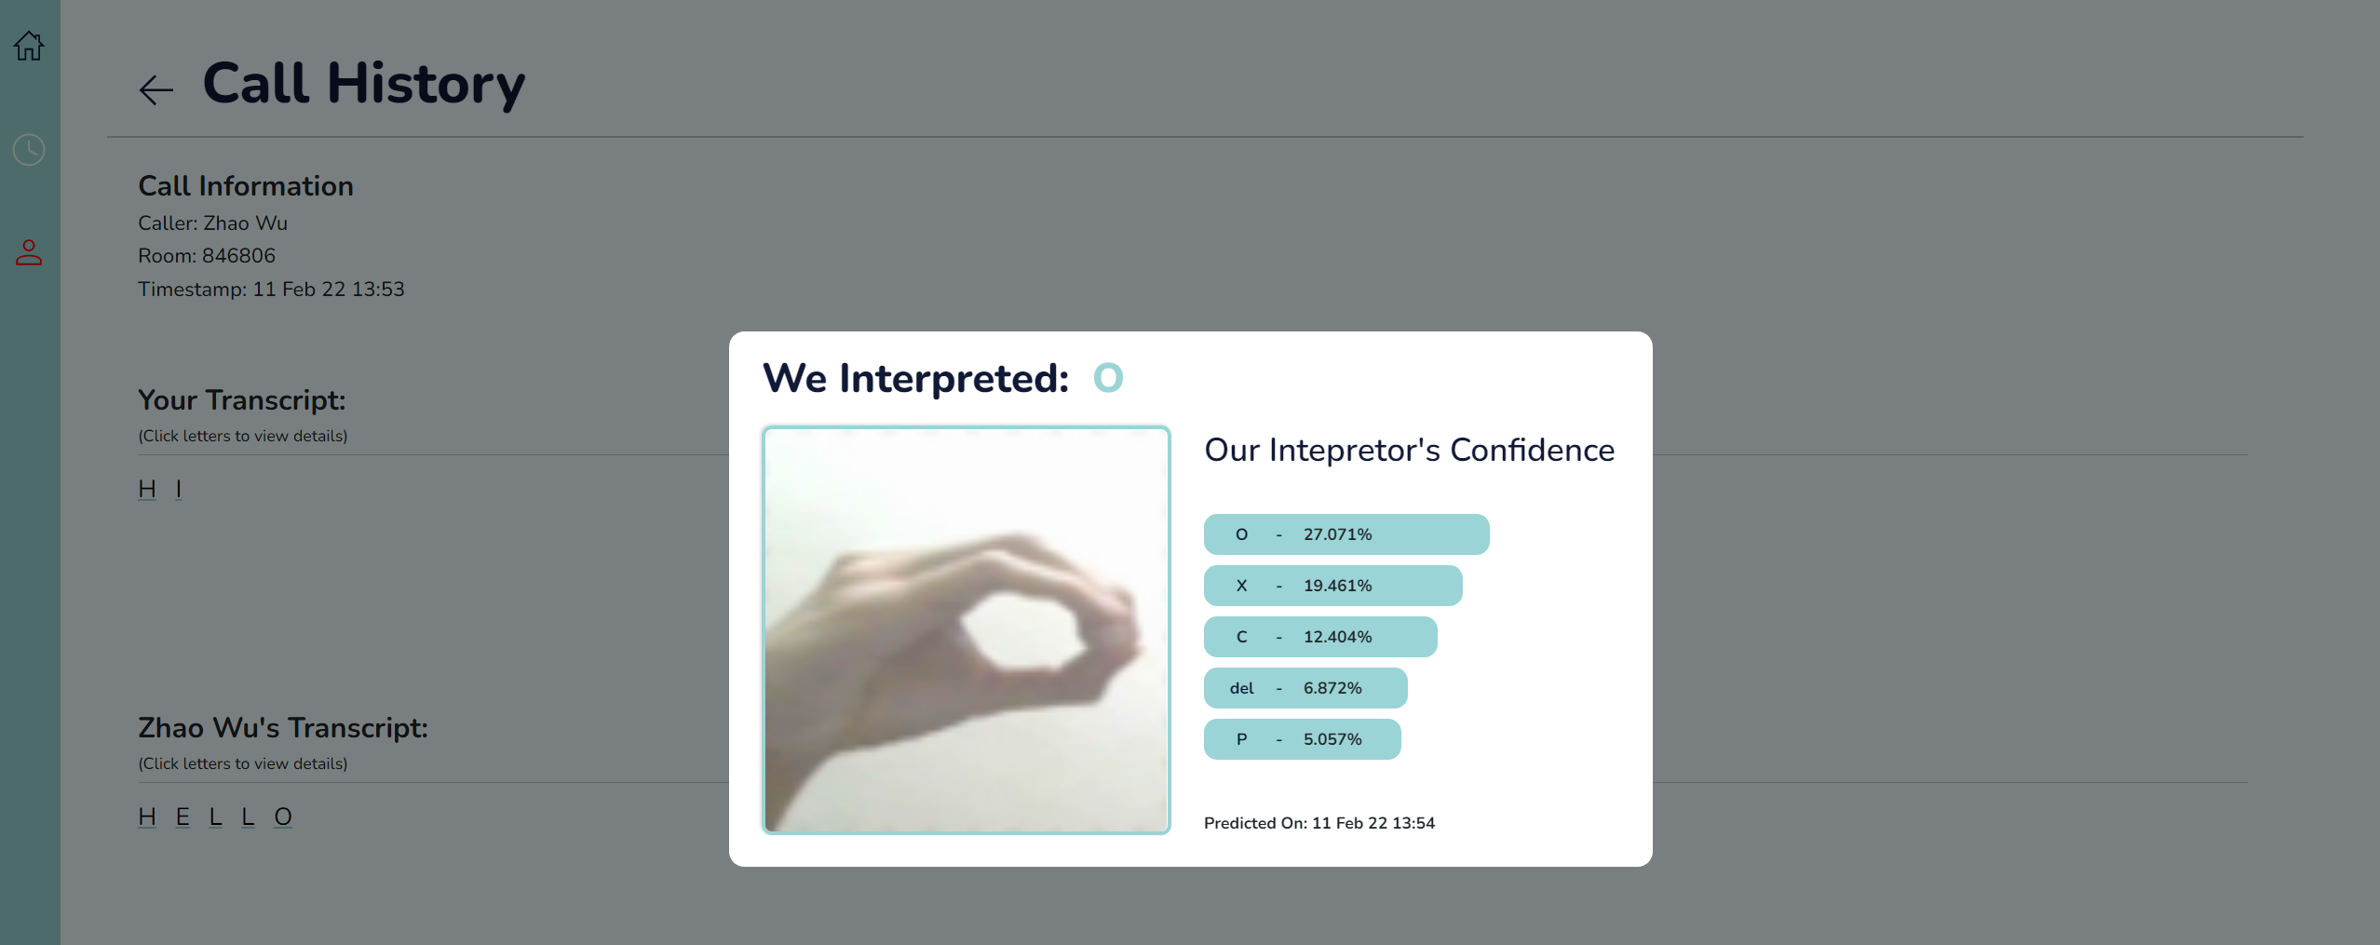
Click letters to view details
Clicking the letters in the transcript brings up a modal that shows more details about that letter.
For example, I clicked the Letter O in the transcript and it brings up this modal. The modal shows what our model interpreted that handsign as and also our interpreter’s confidence on its interpretation using a softmax graph.

Slide 16
Displaying Our Pytest

Slide 17
Tested Features for Rooms
Unit Testing of Joining Room✅
Expected Failure Test of Joining Other Room While Currently In Room✅
Expected Failure Test of Joining Room with bad Room ID✅
Expected Failure Test of Joining Non-existing Room✅
Expected Failure Test of Joining Room that is full✅
Unexpected Failure Test when Joining Room when ALL Rooms are full (0-999999) ✅
Unit Testing of Create Room✅
Unit Testing of Leave Room✅

Slide 18
Tested Features for Users
Validity Testing for Upper and Lower case arguments for string fields✅
Expected Failure and Range Testing for user credentials with arguments beyond valid range✅
Expected Failure and Validity Testing for user credentials with arguments as 0✅
Expected Failure and Validity Testing for user credentials with arguments as None✅
Expected Failure and Validity Testing for duplicated emails✅

Slide 19
Tested Features For Predictions
Validity Testing for Database Entry✅
Expected Failure and Range Testing for Database Entry with invalid data types✅
Expected Failure and Validity Testing for Database Entry with None as input✅
Expected Failure and Consistency Testing for Database Entry with input data in the wrong format✅
Validity Testing for submission of prediction where we verify if the results have been received, if database entries been entered and also if image been saved✅
Unexpected Failure Test if the image is missing or corrupted✅
Unexpected Failure Test if the image is None✅
Unit Testing if the image API returns the image✅
Unexpected Failure Test if the image API does not return any images✅
Validity Test for deletion of prediction where we verify if the images have been deleted and if the database entries have been deleted✅

Slide 20
Links To Heroku, And Account Details

Slide 21
Heroku Links (depreciated)
Heroku Website Link : https://signal-staging-web.herokuapp.com/
Heroku Model Link : https://signal-server-heroku.herokuapp.com/
This web app was once hosted on Heroku before they removed the free hosting plans.

Slide 22
User Accounts (depreciated)
Andric.Ang@gmail.com (Password: andricpassword123)
ZhaoWu@gmail.com (Password: zhaowupassword123)
Steven@gmail.com (Password: stevenpassword123)

Slide 23
Thank You.

